Slide 1
The Salvation of the Soul

Slide 2
1 Peter 3:14-22

Slide 3
Salvation of the Soul
1 PETER
What is the Salvation of the Soul?
The Salvation of the soul is the total transforming work of God upon our lives, which is presently being realized in the midst of Christ like suffering, and which in the future will be unveiled in Christ like glory.

Slide 4
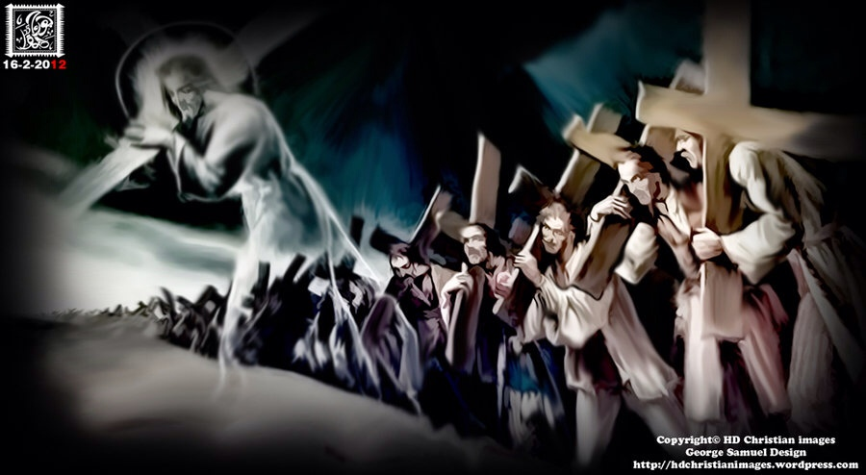
Salvation of the Soul
1 PETER
We are called to patiently endure unjust suffering just as Christ showed us the way to suffer.
Notes:
He not only is the way, the truth and the life, but also shows us the way to suffer, to die, to live. We follow Him in the way to suffer and in the way of submission. Christ’s sufferings are the model on how to respond to injustice, for He experienced the greatest injustice of all. So we too are told to take up your suffering and follow Him in His footsteps.

Slide 5
Salvation of the Soul
1 PETER
Outline

Slide 6
Salvation of the Soul
1 PETER
Body: Salvation of the Soul, Worked out in Experience – 1:13 – 4:19
In Relation:
to God – 1:13-21
to Brethren – 1:22 – 2:10
to the World – 2:11 – 3:7
to Life Itself – 3:8 – 4:6
to the Consummation of History – 4:7-19

Slide 7
Salvation of the Soul
1 PETER
Body: Salvation of the Soul, Worked out in Experience – 1:13 – 4:19
In Relation:
to Life Itself – 3:8 – 4:6
Through the Experience of Blessing – 3:8-12
Through the Experience of Suffering – 3:13 – 4:6
Key Phrase: “For he who desires to love life and see good days.”
Notes:
If we are rightly related to God, to the brethren, and to the world around us, then we are ideally prepared for a long life and good days. And even if we suffer, we are still victorious in the life of our Savior.
The key phrase in this section is, “For he who desires to love life and see good days” Life is lengthened and days are made happy or good by a gracious behavior toward others. And Scripture is repeatedly clear that life is shortened when our days are characterized by wickedness

Slide 8
Salvation of the Soul
1 PETER
Body: Salvation of the Soul, Worked out in Experience – 1:13 – 4:19
In Relation:
to Life Itself – 3:8 – 4:6
Through the Experience of Suffering – 3:13 – 4:6
Suffering for Doing Good – 3:13-17
Suffering Identified through the Medium of Typology – 3:18-22
Suffering with the Same Mind of Christ – 4:1-6

Slide 9
Salvation of the Soul
1 PETER
Through the Experience of Suffering – 3:13 - 4:6
Suffering for Doing Good – 3:13-17
Blessings from God for Good Conduct
Sufferings from Man for Good Conduct
“if you should suffer for righteousness sake”
Notes:
Peter present the principles of suffering for good conduct in verses 13-17, and then provides examples of suffering for good conduct through the medium of typology in verses 18-22.

Slide 10
Salvation of the Soul
1 PETER
Through the Experience of Suffering – 3:13 - 4:6
Suffering for Doing Good – 3:13-17
“But even if you should suffer for righteousness' sake, you are blessed.” (3:14a)
Notes:
In the first subsection, vs 8-12 Peter explains that the salvation of the soul is experienced through life itself by gaining a long and happy life that good conduct brings to it from God. There is only blessing from God for living a righteous life. But what about man? What can we expect man to bring to us for living a life of good conduct. Tranquility is normally to be expected from such a life, but should suffering come, there is blessedness even in it.
Hodges considers this to be a fourth class condition, indication a less probable future. In other words, the outcome does not look at suffering as the normal or expected fruit of holy living.
This does not contradict Paul’s statement in 2 Timothy 3:12 that suffering is be expected, “Yes, and all who desire to live godly in Christ Jesus will suffer persecution.” These persecutions that Paul experience came from men. And he continues to say that evil men and imposters will grow worse and worse, implying that persecutions will grow worse and worse. Here Peter states that all who live godly should not expect to suffer. Suffering is a necessary part of the experience of the sojourners in this life as Peter makes plain in 1:3-12, “though now for a little while, if need be, you have been grieved by various trials,”. On the other hand, suffering is not the normal, usual result of a righteous life. “All Peter means to say is that ‘even if suffering should—and it might conceivable—result from righteousness…” (Hodges, p.64)
On an other hand, sin is a quicker path to trouble and suffering that holiness or right conduct. The life of the sinner is filled with trouble, hurt and suffering, more so than a saint.
All Peter is saying is like in the Psalm a general truth is normally true. But he allows for a conceivable exception. These are general truths rather than universal or absolute truths.
We should not be surprised when persecution or suffering for doing good comes from men, spite the fact of believers desire to live peacefully and their eagerness to do good.

Slide 11
Salvation of the Soul
1 PETER
Through the Experience of Suffering – 3:13 - 4:6
Suffering for Doing Good – 3:13-17
“And who is he who will harm you if you become followers of what is good?... ‘And do not be afraid of their threats, nor be troubled.” (3:13, 14b)
Notes:
Who is he that will harm you for doing good? Not God, but man.
Peter quotes Isaiah 8:12. Israel and king Ahab were fearful of the threats of men and the impending invasion to destroy them. But Isaiah urged them not to fear in men but to trust in the Lord of host. “Nor be afraid of their threats, nor be troubled. The Lord of hosts, Him you shall hallow; Let Him be your fear, and let Him be your dread. He will be as a sanctuary,…” (Isa. 8:12b-14a)

Slide 12
Salvation of the Soul
1 PETER
Through the Experience of Suffering – 3:13 - 4:6
Suffering for Doing Good – 3:13-17
“But sanctify the Lord God in your hearts, and always be ready to give a defense to everyone who asks you a reason for the hope that is in you, with meekness and fear.” (3:15)
Notes:
Sanctify, that is, set apart the Lord God in your heart/mind to trust and fear Him and not to fear what man may say. When we suffer unjustly without fear or terror of men, they will ask our secret. When men see the lack of fear we have in their threats and the trust we have for the Lord they will then ask for the reason. We are to be ready to give an “apologia”, a defense, with gentleness and respect. Our response should not be given in an arrogant manner. “Christians who are not afraid in the face of persecution are able to witness respectfully to their faith in Christ.” (BKC, p.850)
When Peter was with Jesus he was fearless, walking on water and standing up against and ready to take on a whole Roman legion with a single sword. But when separated from Jesus he coward in fear, cursing that he never knew him. Peter denied Christ out of fear of men, that was neither gentle nor respectful.

Slide 13
Salvation of the Soul
1 PETER
Through the Experience of Suffering – 3:13 - 4:6
Suffering for Doing Good – 3:13-17
“having a good conscience, that when they defame you as evildoers, those who revile your good conduct in Christ may be ashamed.” (3:16)
Notes:
“Peter is saying that we are to maintain a good conscience during our sufferings, so that the abusers or our “in-Christ way of life” may be put to shame.” (Hodges, 65) Good behavior is the best defense against unjust punishment and persecution.

Slide 14
Salvation of the Soul
1 PETER
Through the Experience of Suffering – 3:13 - 4:6
Suffering for Doing Good – 3:13-17
“For it is better, if it is the will of God, to suffer for doing good than for doing evil.” (3:17)
Notes:
Everyone suffers. But it is far better to suffer for doing good that for doing evil. There is no commendation for suffering for doing evil, for one receive what they rightly deserve. And it is even better to suffer for doing good with a good conscience while the suffering is going on this will lead to blessedness and a greater fellowship with Christ.

Slide 15
Salvation of the Soul
1 PETER
Body: Salvation of the Soul, Worked out in Experience – 1:13 – 4:19
In Relation:
to Life Itself – 3:8 – 4:6
Through the Experience of Suffering – 3:13 – 4:6
Suffering for Doing Good – 3:13-17
Suffering Identified through the Medium of Typology – 3:18-22

Slide 16
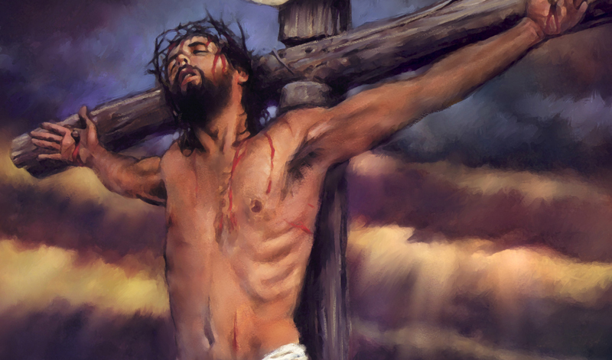
Salvation of the Soul
1 PETER
Suffering Identified through the Medium of Typology
“For Christ also suffered once for sins, the just for the unjust, that He might bring us to God, being put to death in the flesh but made alive by the Spirit.” (3:18)
Notes:
The word “for” give the reason why it is better to suffer for doing good than for doing evil. It is morally superior because suffering evil is utterly out of place for us, Christ has already suffered for us once for all. If Christ suffered for sins once, why should we suffer for them at all? He suffered for sin to bring us to God safely. “To suffer for evil is, therefore, entirely out of harmony with what He did and where we are now.” (Hodges, p 66)

Slide 17
Salvation of the Soul
1 PETER
Suffering Identified through the Medium of Typology
“by whom also He went and preached to the spirits in prison, who formerly were disobedient, when once the Divine longsuffering waited in the days of Noah, while the ark was being prepared, in which a few, that is, eight souls, were saved through water.” (3:19-20)
Notes:
Verses 19-22 establishes our identification with the experience of being put to death in the flesh but made alive by the Spirit through the medium of typology or picture form.
The digression about Noah is an illustration of the whole truth involved. Chapter 4:1 resumes the thought about Christ dying and rising, and joins the identification truth presented in these verses.
The key link is the thought of the spirit. Verse 18 declares in the sphere of the flesh, Christ suffered death. In the sphere of the spirit He rose to life. “Peter is going to show by way of typology how we too have shared Christ’s dying and rising experience. And he is going to show that, having shared this “once for all” experience with Christ, suffering for sin and living in sin, has no place in our experience. Continuing to live in sin will not bring about the salvation of the soul.

Slide 18
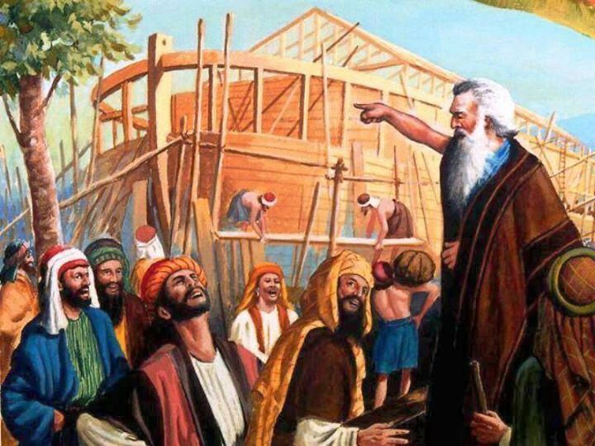
Salvation of the Soul
1 PETER
Suffering Identified through the Medium of Typology
“Noah was “a preacher of righteousness” (2 Pt. 2:5)
Christ preached to the spirits through Noah of their coming dome.
Notes:
“He went” or “having gone” does not refer to Christ descending into hell, but to His going to spirits who are now in prison in the person of Noah. “Noah was, after all, “a preacher of righteousness” (2 Pt. 2:5). “in which” refers to the Spirit of Christ operative in Noah’s day.
“By faith Noah, being divinely warned of things not yet seen, moved with godly fear, prepared an ark for the saving of his household, by which he condemned the world and became heir of the righteousness which is according to faith.” (Heb. 11:7)
Gen 6:3
And the Lord said, "My Spirit shall not strive with man forever…”
Peter had already mentioned that “the Spirit of Christ who was in the prophets…”
1 Peter 1:10-11
Of this salvation the prophets have inquired and searched carefully, who prophesied of the grace that would come to you, searching what, or what manner of time, the Spirit of Christ who was in them was indicating when He testified beforehand the sufferings of Christ and the glories that would follow.”

Slide 19
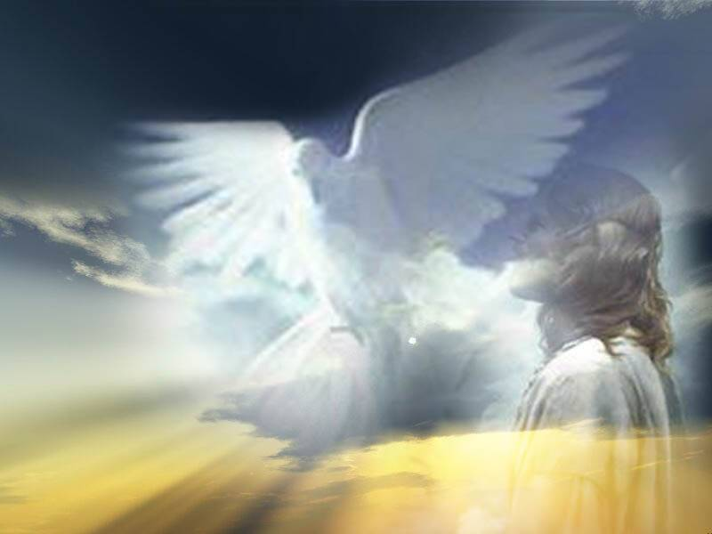
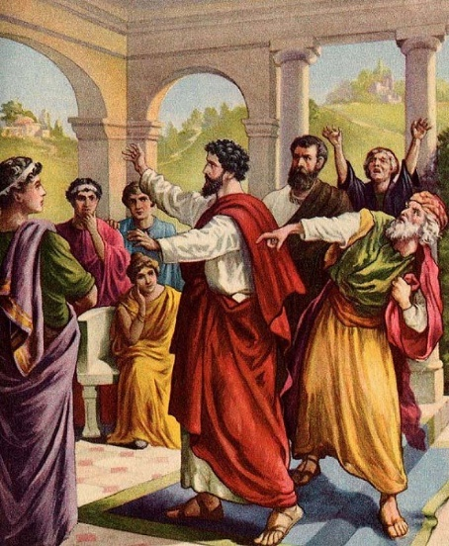
Salvation of the Soul
1 PETER
Suffering Identified through the Medium of Typology
“And He came and preached peace to you who were afar off and to those who were near.” ( Eph. 2:17)
Christ preached to the Ephesians through men by His Spirit.
Notes:
Eph. 2:17
“And He (Christ) came and preached peace to you who were afar off and to those who were near…”
Christ preached to the Ephesian in Spirit through the those men who brought the gospel of peace to them. “When the servants of God preach, Christ is preaching through them, in Spirit.” (Hodges, 69)

Slide 20
Salvation of the Soul
1 PETER
Suffering Identified through the Medium of Typology
“by whom also He went and preached to the spirits in prison, who formerly were disobedient,” (3:19-20)
“spirits” used 32x’s in the NT [NKJV], all refer to either good or unclean spirits, mostly demons. Only once does in it refer to “spirits of just men” (Hebrews 12:23)
Notes:
Who are the “spirit” that the spirit Christ spoke to through Noah?
The use of “spirits” is almost exclusively a reference to unclean spirits, demons.
For example, “For with authority He commands even the unclean spirits, and they obey Him” (Mark 1:27) “And at once Jesus gave them permission. Then the unclean spirits went out and entered the swine…” (5:13)
These are disobedient spirits, not righteous spirits.
“in or by the spirit”… “He went and preached to spirits who were formerly disobedient” The “prison” does not refer to were the spirits were in Noah’s day, but were they are now. These spirits who were disobedient before the flood, Christ preached by His Spirit through Noah are now in prison being held there until the final judgment.
2 Peter 2:4-5
“For if God did not spare the angels who sinned, but cast them down to hell and delivered them into chains of darkness, to be reserved for judgment; and did not spare the ancient world, but saved Noah, one of eight people, a preacher of righteousness, bringing in the flood on the world of the ungodly;”
Jude 6
“And the angels who did not keep their proper domain, but left their own abode, He has reserved in everlasting chains under darkness for the judgment of the great day…”
Being in “chains” is equivalent to being “in prison”. Paul said in Ephesian (one of the prison epistles) “I am an ambassador in chains;” (Eph. 6:20). In Hebrews 11, the Hall of Faith, it mentions “others had a trial of mockings and scourgings, yes, and of chains and imprisonment.” (Heb.11:36-37)
The “spirits” are also called the sons of God…
Gen 6:1-2
“Now it came to pass, when men began to multiply on the face of the earth, and daughters were born to them, that the sons of God saw the daughters of men, that they were beautiful; and they took wives for themselves of all whom they chose…”
Job 1:6; 2:1
“Now there was a day when the sons of God came to present themselves before the Lord, and Satan also came among them… Again there was a day when the sons of God came to present themselves before the Lord, and Satan came also among them to present himself before the Lord.”
Job 38:4, 7
"Where were you (Job) when I laid the foundations of the earth?” Job or no man was present until the sixth day but the angels were there apparently on the first day – “When the morning stars sang together, and all the sons of God shouted for joy?”
Jesus said that those who attain “the resurrection from the dead, neither marry nor are given in marriage; nor can they die anymore, for they are equal to the angels and are sons of God, being sons of the resurrection.” (Luke 20:35-36)
Peacemakers shall be called sons of God (Mt. 5:9) Those who are lead by the Spirit, are Sons of God”. (Rom. 8:14) The creation eagerly awaits the revealing of the sons of God.” (8:19) “For you are all sons of God through faith in Christ Jesus” (Gal. 3:26).
Rev 18:2-3
“An angel… cried mightily…"Babylon the great is fallen, is fallen, and has become a dwelling place of demons, a prison for every foul spirit, and a cage for every unclean and hated bird!”
Rev 20:7
“Now when the thousand years have expired, Satan will be released from …”
his prison
“in prison” mostly refers to saints (i.e.: John the Baptist, Peter, Paul, who are in prison. “Peter was therefore kept in prison…” (Acts 12:5) and Paul said, “This I also did in Jerusalem, and many of the saints I shut up in prison…” (26:10).

Slide 21
Salvation of the Soul
1 PETER
Suffering Identified through the Medium of Typology
Who did the Preaching?
Christ Preached
Who did He Preach too?
Unclean Spirits
How did He Preach?
In His Spirit through Noah
When did He preach?
In the days Noah
What did He Preach?
Impending Judgment
Notes:
Christ preached impending doom through Noah by His Spirit to the unclean spirits who were influencing the hearts or minds of men in the days or years prior to the flood. “The relevance of this thought in context is the hidden concept of hostile principalities and powers who operate through unregenerate to make life difficult for Christians.” (3:22) As in Noah’s day the “in Spirit Messiah” proclaimed there doom, so today their doom is also proclaimed and is sure because He who was quickened “made alive” and is in heaven is exalted above them.” (Hodges, p. 70) that is, the angels and authorities and powers having been made subject to Him.

Slide 22
Salvation of the Soul
1 PETER
Suffering Identified through the Medium of Typology
“by whom also He went and preached to the spirits in prison, who formerly were disobedient, when once the Divine longsuffering waited in the days of Noah, while the ark was being prepared, in which a few, that is, eight souls, were saved through water.” (3:19-20)
Notes:
Note: Verses 19-20 involves three elements in God’s dealing with man: proclamation, patience and preservation. All three have parallels and relevance for Peter’s day and ours. We need to know that the rebellious, who are doomed in divine judgement are without excuse, they are responsible, hear the proclamation of its coming. God is waiting in great patience before the judgment comes, while the church (Ark) is being built. There is salvation, but for a few who heed the call in comparison to the mass of mankind.

Slide 23
Salvation of the Soul
1 PETER
Suffering Identified through the Medium of Typology
“There is also an antitype which now saves us — baptism (not the removal of the filth of the flesh, but the answer of a good conscience toward God), through the resurrection of Jesus Christ, who has gone into heaven and is at the right hand of God, angels and authorities and powers having been made subject to Him.” (3:21-22)
Notes:
This a very difficult passage to untangle. The first deals with the word “antitype”, “antitupos” – corresponding counterpart, “like figures” [KJV]’ “corresponding” [NASB]
“topus” – resemblance, model, fashion, pattern, form, example, a copy; “a pattern to be followed”; Literally “to make a mark”
Types “are merely illustrations; and it would be better so to call them; inasmuch as they did not and do not of themselves teach the truths, but only illustrate those truths which are elsewhere clearly revealed.” (Bullinger's Figures of Speech Used in the Bible, PCSB Topical Edition. Copyright © 2013 by Biblesoft, Inc. All rights reserved.)
An example of a type is found in Hebrews 9:24, “For Christ has not entered the holy places made with hands, which are copies [figure] of the true, but into heaven itself…”
The earthly tabernacle and temple were the types, the model or shadow of the antitype, the heavenly temple in which Christ entered.
Here, the type is water baptism which is a outward illustration of the inner or hidden work of the spirit, “spirit baptism” which is the antitype. Water baptism is a visional illustration of an invisible spiritual work of the spirit that occurs at the moment of faith in Christ, that places the believer into the body of Christ.
The spirit baptism “saves us” including the salvation of the soul, “psyche”. We are not talking about “baptism regeneration” which says that water baptism saves the sinner for eternal punishment and regenerates, gives eternal life, that is, born again.
Noah and the ark are “also” a type, or a copy of a salvation of the soul, in which eight souls “psyche” were saved from a watery death. Spirit baptism the antitype of a spiritual reality which was foreshadowed in Noah’s day. Just as Noah and company was placed “into” the Ark saved eight souls from judgement and death, spirit baptism places “us” into Christ’s saving us from divine judgment and from the spirits who have been made subject to Him.

Slide 24
Salvation of the Soul
1 PETER
Baptism, a Work of Christ through the Spirit
Christ enters the sphere of the Spirit.
The Ark is an appropriate image of Christ/Church into which we are placed in Spirit baptism.
Spirit baptism mightily effects and includes “us”.
Spirit baptism is the key to the phrase “in Christ”, making a connection to Romans 6.
Notes:
Four arguments for regarding baptism as a reference to the work of Christ through the Spirit.
The section begins (vs.18) with Christ’s entrance by resurrection into the sphere of the Spirit. Verses 19-22 establishes our identification with the experience of being put to death in the flesh but made alive by the Spirit through the medium of typology or picture form. The “in which” or “in whom” carries forward the stress of the “spirit nature” of the illustration.
Second, the Ark is actually in which the eight souls are placed saves them. It is not the water. The Ark is a appropriate image/type of Christ and/or the church into which we are placed in the Spirit’s baptism. Notice in eight souls were saved when they went “into” the Ark.
Third, Peter uses “us” in reference to the effects of our baptism, including himself. It mightily effects us.
Forth, Peter had already mention in verse 16 the typically Pauline phrase “in Christ” Spirit baptism is the key to the phrase “in Christ”, making a connection to Romans 6. Peter is presenting the Paul’s doctrine of Romans 6.
Rom 6:1-11
“What shall we say then? Shall we continue in sin that grace may abound? Certainly not! How shall we who died to sin live any longer in it? Or do you not know that as many of us as were baptized into Christ Jesus were baptized into His death? Therefore we were buried with Him through baptism into death, that just as Christ was raised from the dead by the glory of the Father, even so we also should walk in newness of life. For if we have been united together in the likeness of His death, certainly we also shall be in the likeness of His resurrection, 6 knowing this, that our old man was crucified with Him, that the body of sin might be done away with, that we should no longer be slaves of sin. For he who has died has been freed from sin. Now if we died with Christ, we believe that we shall also live with Him, knowing that Christ, having been raised from the dead, dies no more. Death no longer has dominion over Him. For the death that He died, He died to sin once for all; but the life that He lives, He lives to God. Likewise you also, reckon yourselves to be dead indeed to sin, but alive to God in Christ Jesus our Lord.”
The climax of Christ going into heaven seating at the right of God having made the spirits subject to Him recalls Col. 2:11-15 and Eph. 1:20 – 2:10.
Col 2:11-15
“In Him you were also circumcised with the circumcision made without hands, by putting off the body of the sins of the flesh, by the circumcision of Christ, buried with Him in baptism, in which you also were raised with Him through faith in the working of God, who raised Him from the dead. And you, being dead in your trespasses and the uncircumcision of your flesh, He has made alive together with Him, having forgiven you all trespasses, having wiped out the handwriting of requirements that was against us, which was contrary to us. And He has taken it out of the way, having nailed it to the cross. Having disarmed principalities and powers, He made a public spectacle of them, triumphing over them in it.”
Eph 1:20-21; 2:4-8
The Father of glory, “worked in Christ when He raised Him from the dead and seated Him at His right hand in the heavenly places, far above all principality and power and might and dominion, and every name that is named, not only in this age but also in that which is to come… But God, who is rich in mercy, because of His great love with which He loved us, even when we were dead in trespasses, made us alive together with Christ (by grace you have been saved), and raised us up together, and made us sit together in the heavenly places in Christ Jesus, that in the ages to come He might show the exceeding riches of His grace in His kindness toward us in Christ Jesus.”
In both of these passages baptism truth and triumph of Christ over angelic powers are closely linked. In Peter’s illustration like the Ark resting on Mt. Ararat through baptism we pass safely through the waters of death and have been “brought to God”

Slide 25
Salvation of the Soul
1 PETER
Conclusion
Notes:
We save our souls when we continue to trust in Jesus, even when we suffer and are grieved by various trial, even when we suffer for doing good. We follow in His footsteps. This is the salvation of the soul.

Slide 26
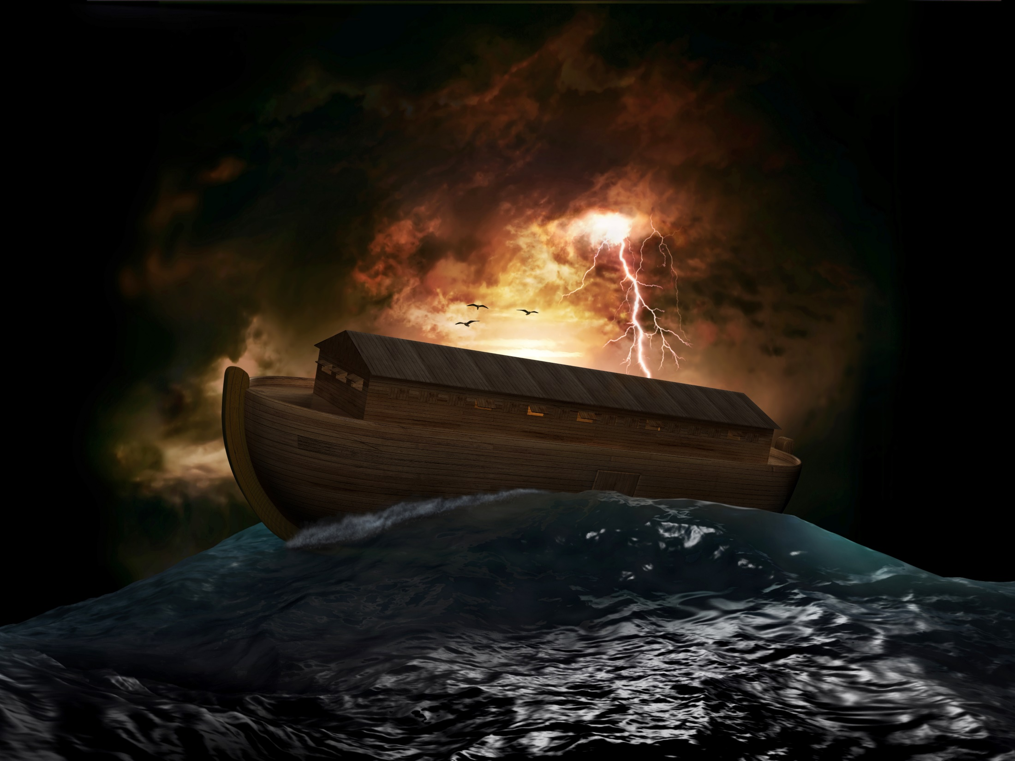
Salvation of the Soul
1 PETER
Spirit Baptism
Ark / Christ
Hostile Doomed World

Slide 27
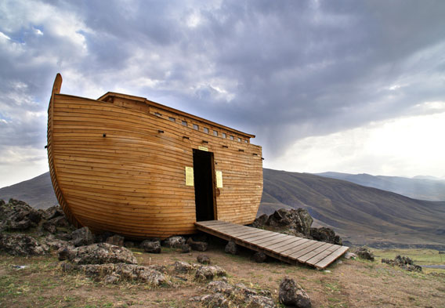
Salvation of the Soul
1 PETER
Through Spirit baptism we are linked to Christ’s dying and rising experience and are safely brought
to God.

